Slide 1
Bullet chess
Lucas Coveyduck, Ehsan Hussain,
Tegran Tamrazayan, Ravneet Singh

Slide 2
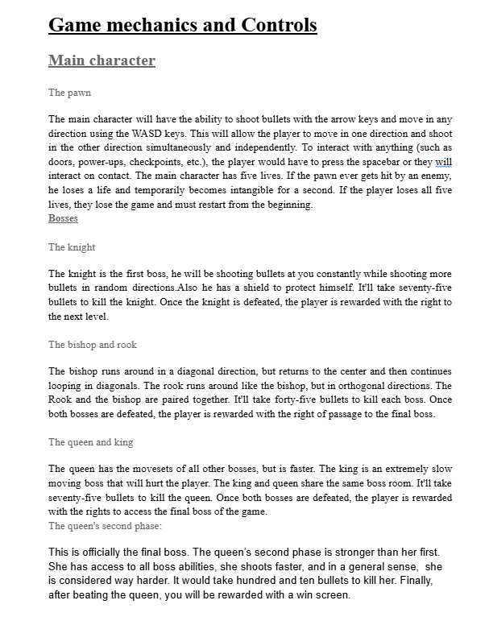
Photo of the main sections of our Game Design Document

Slide 3
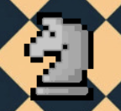
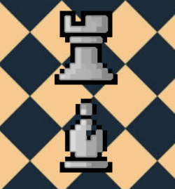
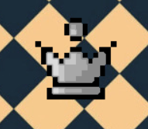
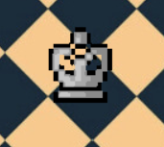
Tegran - AI programmer
What was done
The making of all bosses and their abilities.
Boss/ mini enemies health bars.
Made the player’s movement/ dashing
Helped with some functions of the transitions around the map.
Made the player damage the bosses with abilities.
What went well
Thinking of the boss mechanics, very easy to put into practice.
What went wrong
I quickly ran out of ideas for abilities.

Slide 4
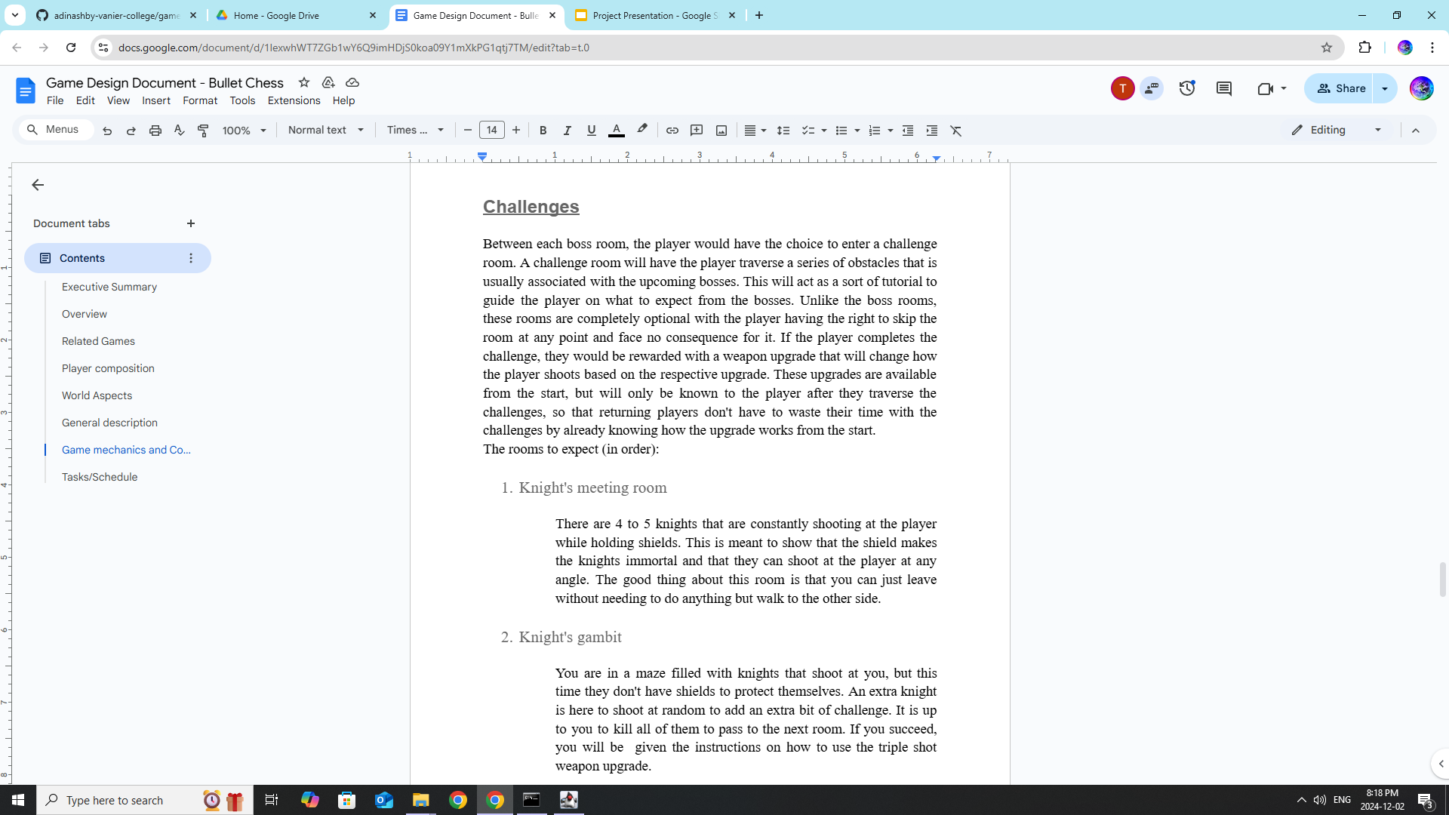
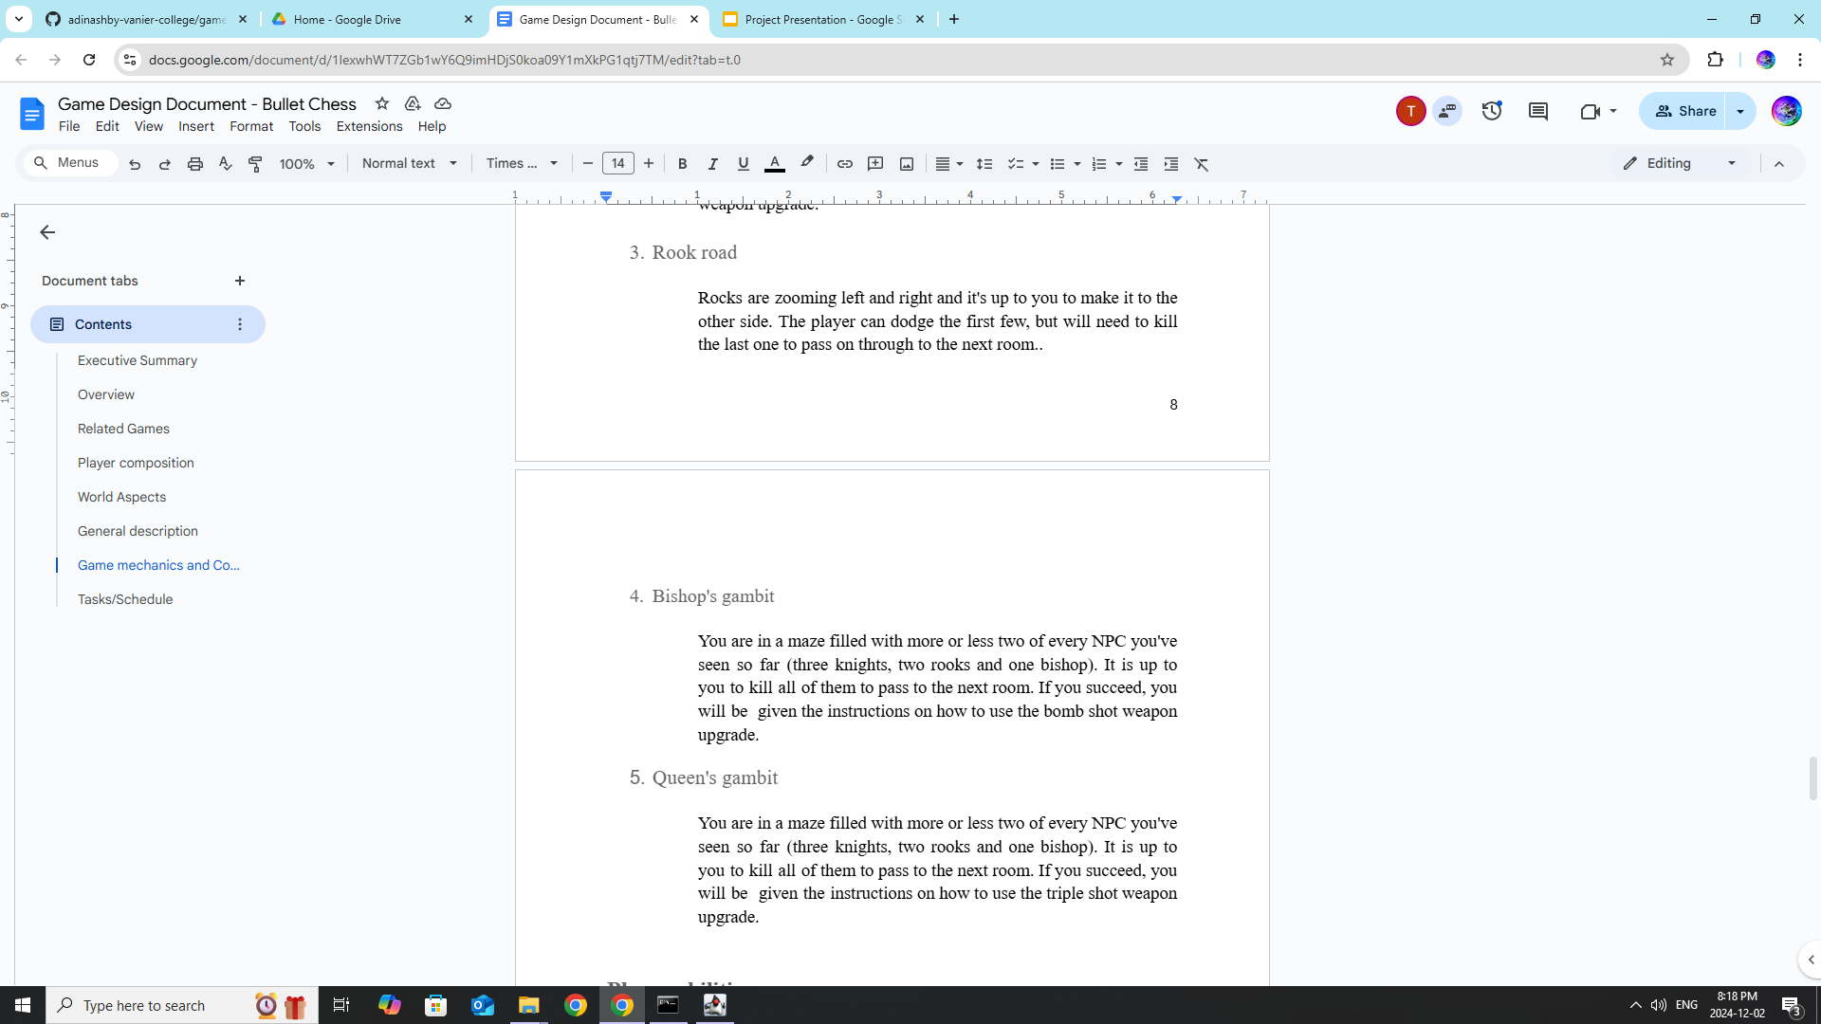

Slide 5
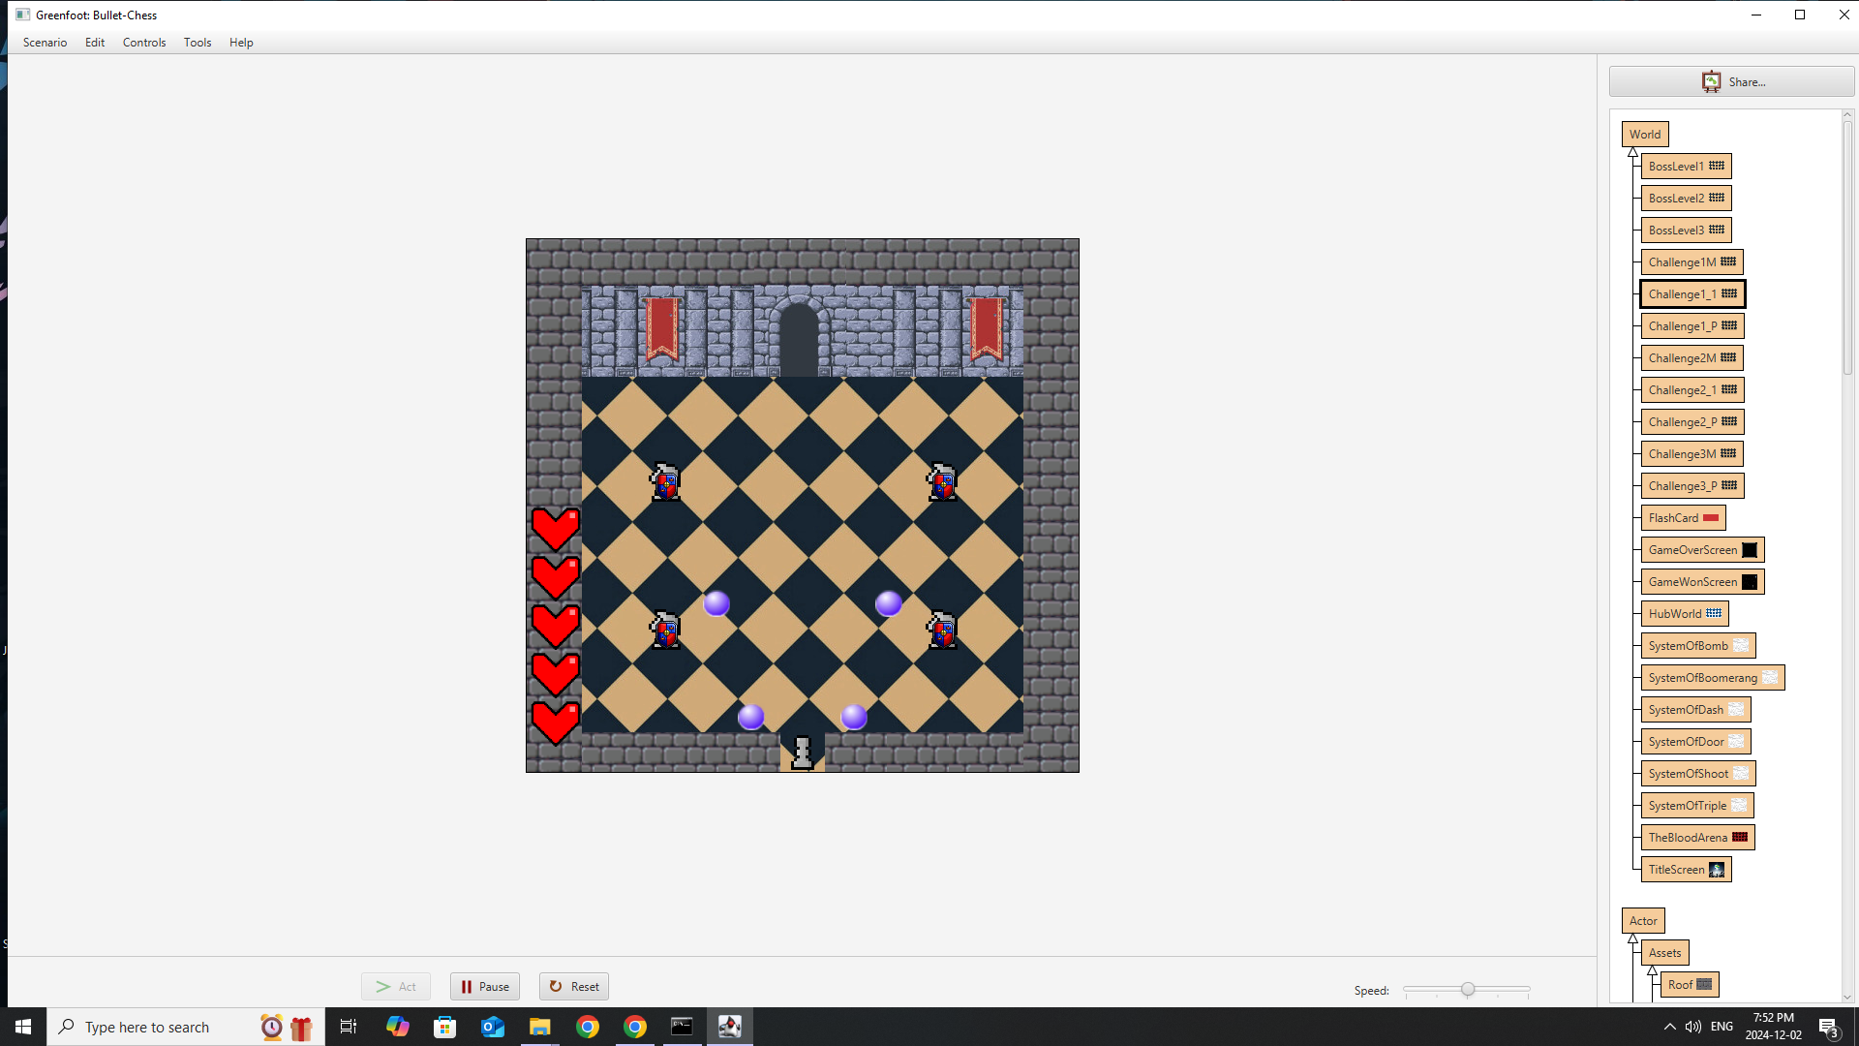
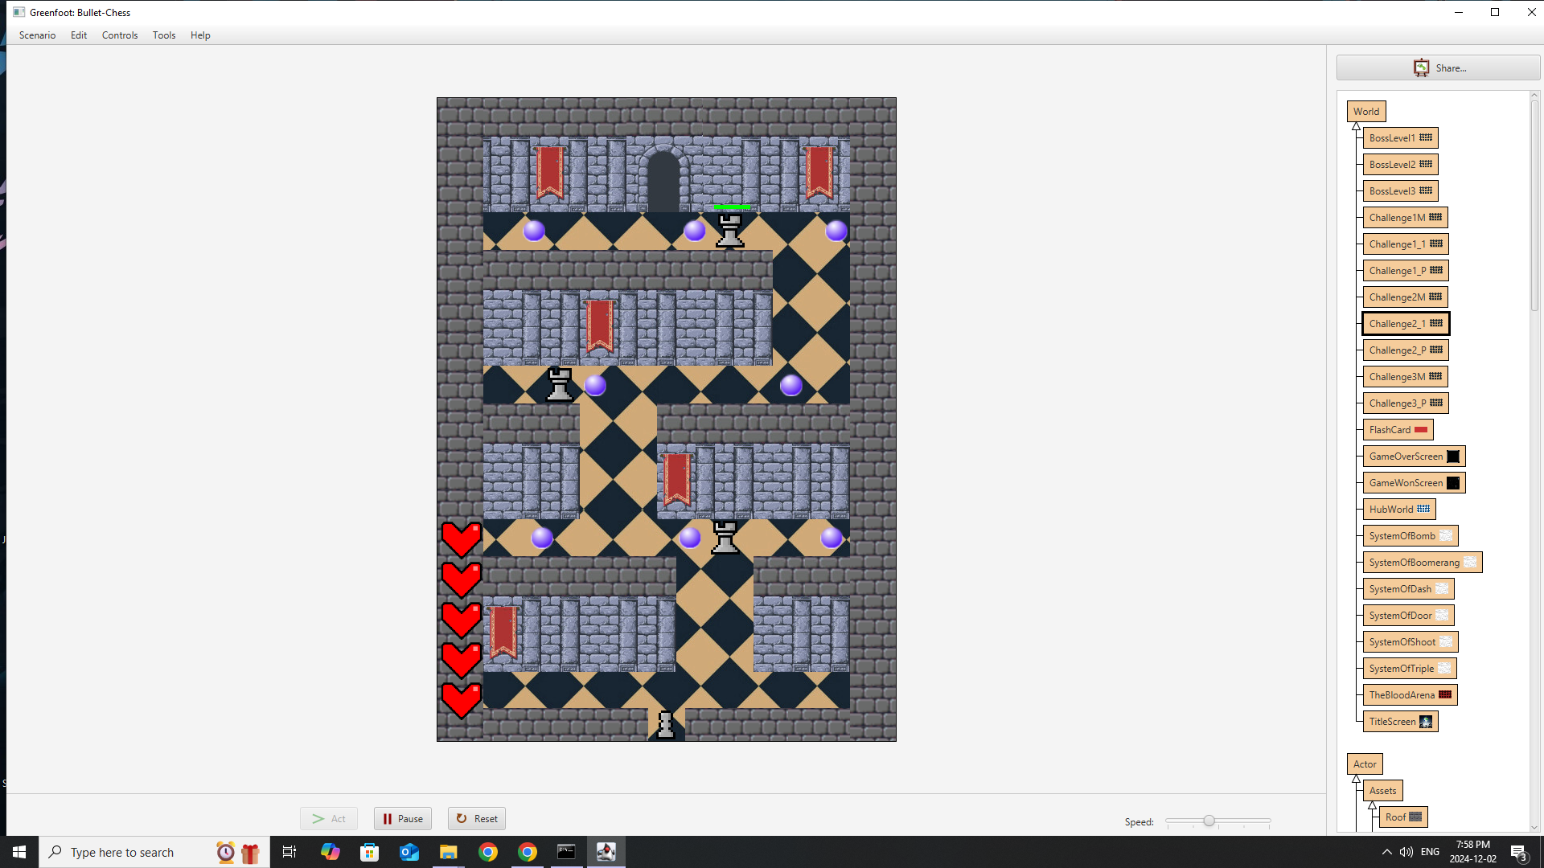
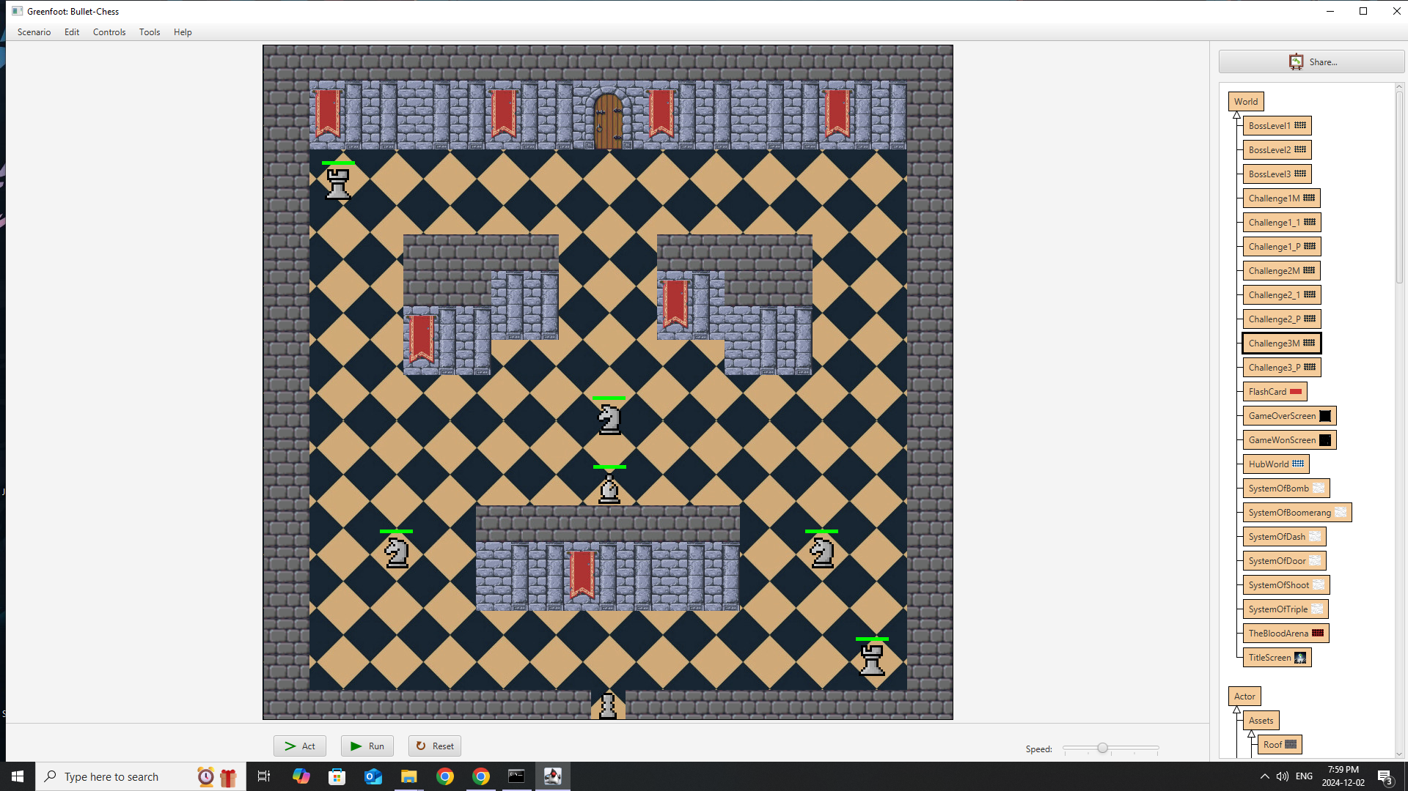
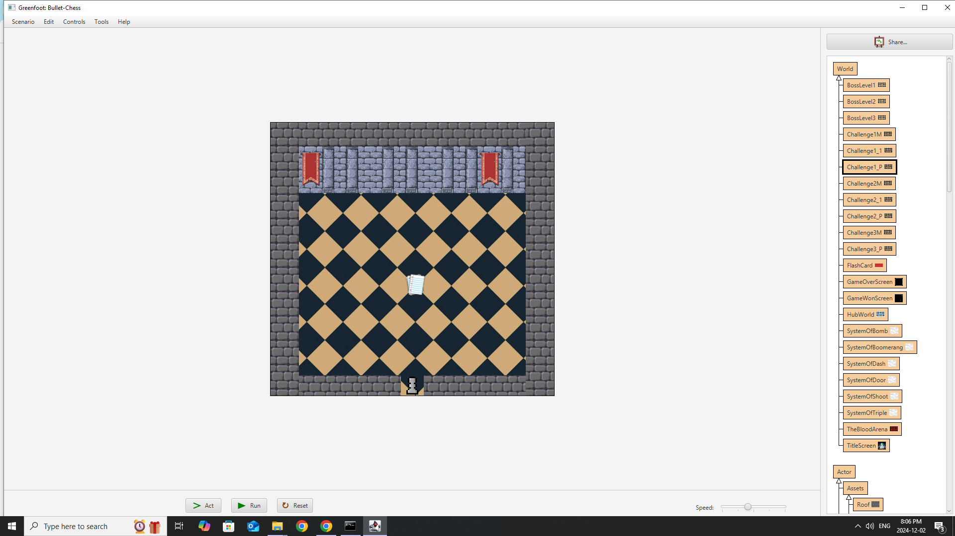
Ehsan - level designer
What was done
Created level geometry
Created challenge room NPCs
What went well
Creating workable assets
Constructing level layouts
What went wrong
Reworking bosses for challenge rooms
Redesigning levels

Slide 6
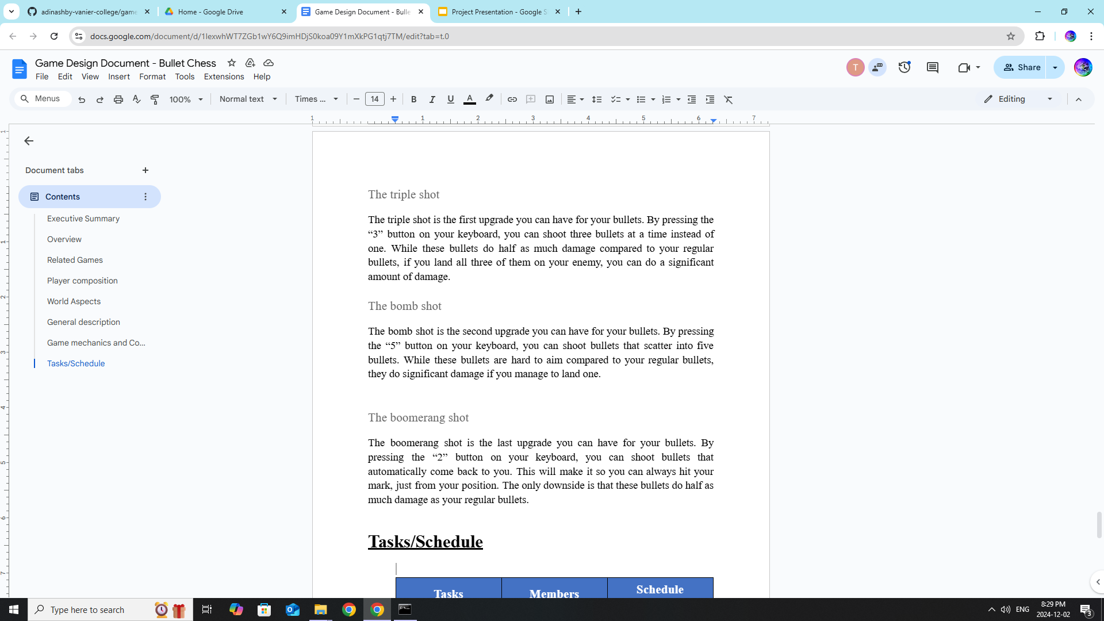

Slide 7
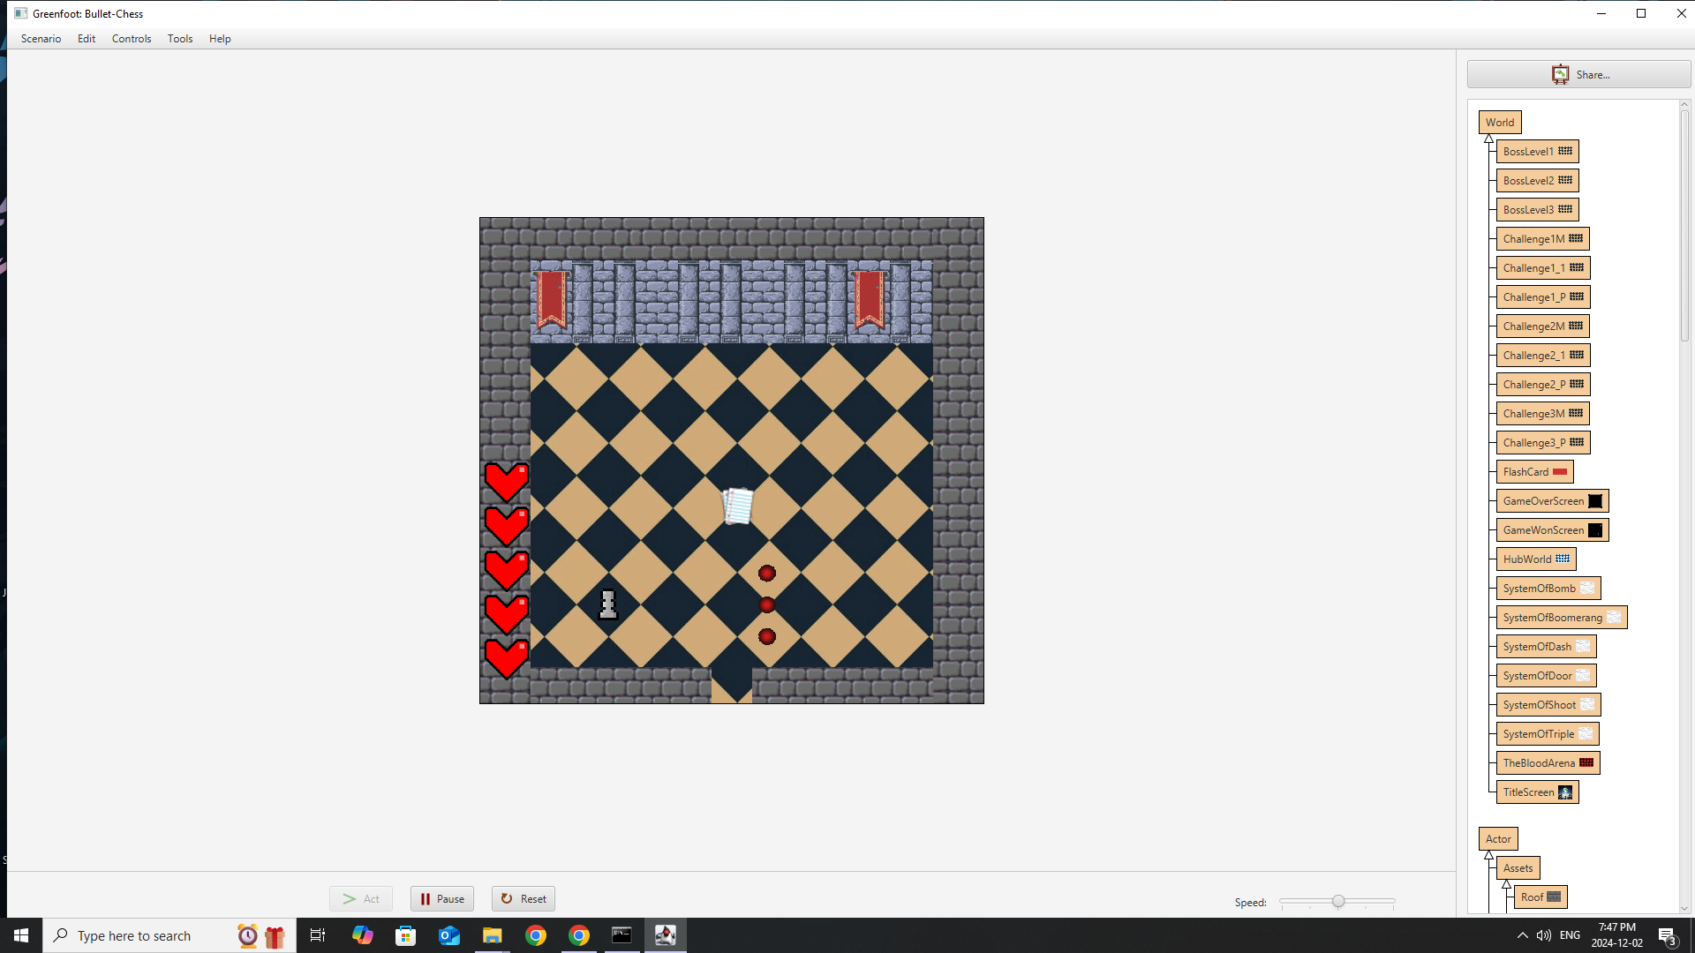


Ravneet - combat designer
What was done
Made the Player Abilities
What went well
Getting the power ups to coexist
Setting up the abilities exactly as the original thoughts
What went wrong
Getting the code to work the way that I wanted
Trying to get a power up to work which we had to discard afterwards

Slide 8
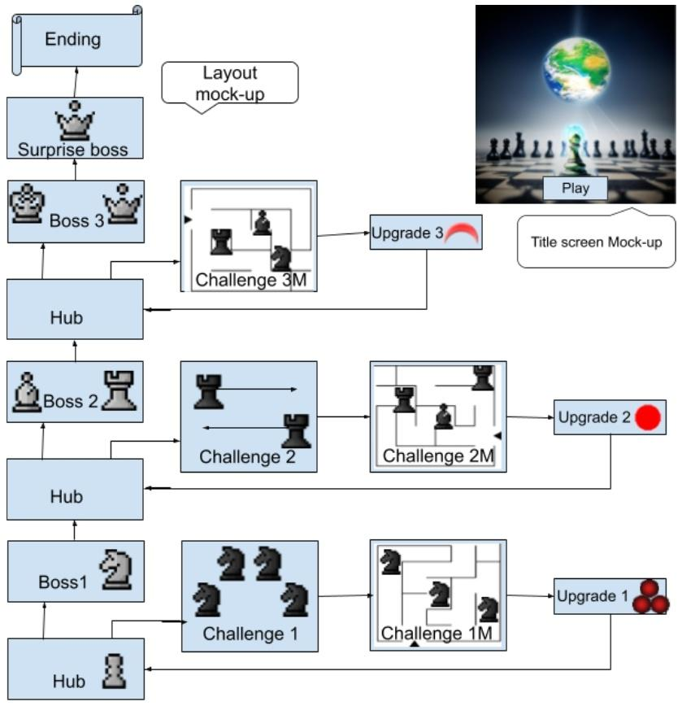
Photo of the main sections of our Game Design Document

Slide 9
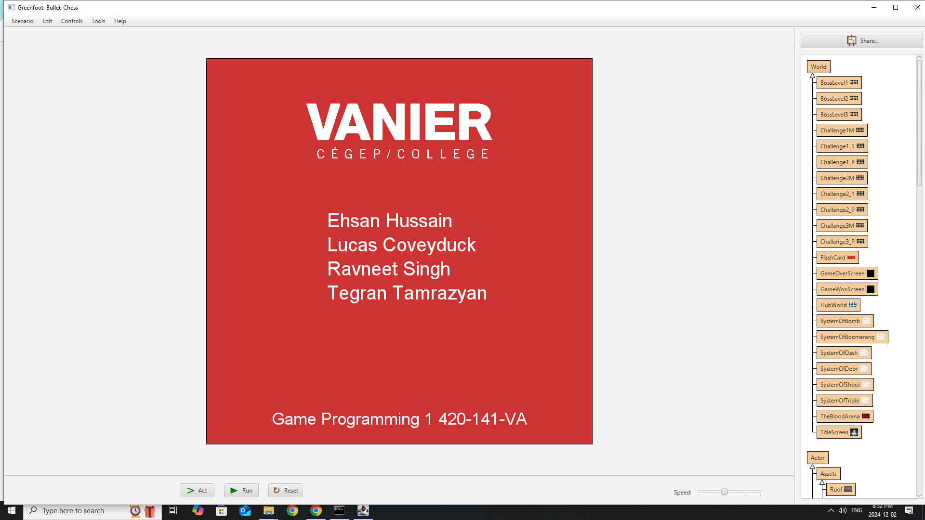
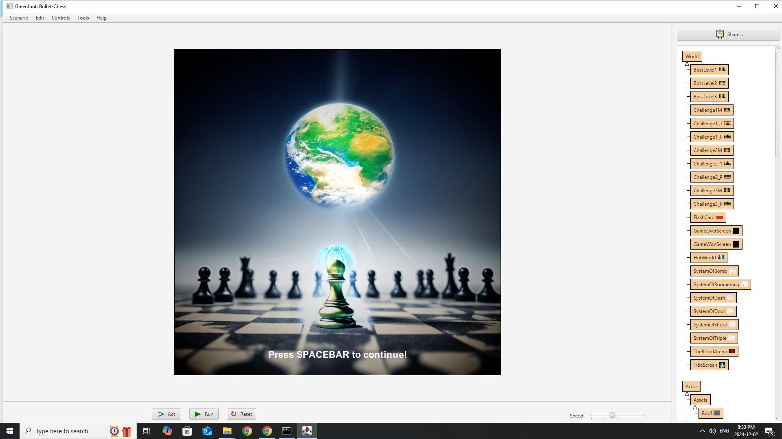
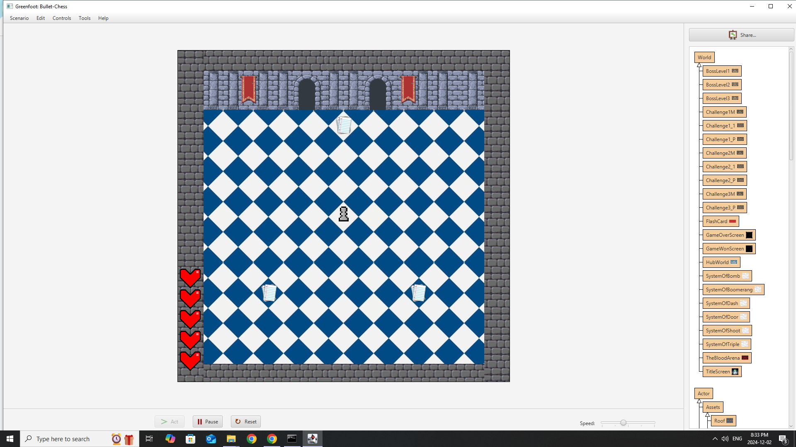
Lucas - UI Designer and Transition Specialist
What was done
Flash card and Menus
Transitions
Health System
What went well
Health UI went perfect
Transitions flow smoothly (with Greenfoot’s limitations)
What went wrong
2 weeks attempting to create checkpoints
Various Transition and Fading bugs

Slide 10
Demo .
(paste the greenfoot link in here!)

